Slide 1
2025/26 TOT Grant Program WORKSHOP
Presented By:
Ger Chang, Program Coordinator
Bryn Saunders, Liability Property Insurance Analyst
Shelly Willis, Grant Consultant
Radtana Lee, Technical Support/Q&A

Slide 2
PRESENTATION OUTLINE
TOT Grant Program Overview
Timeline
Insurance Requirements
Application Guidelines & Eligibility
Online Application – TOT Grant Portal (Foundant)
Application Guide
Application Review
What Happens Next?
Q&A

Slide 3
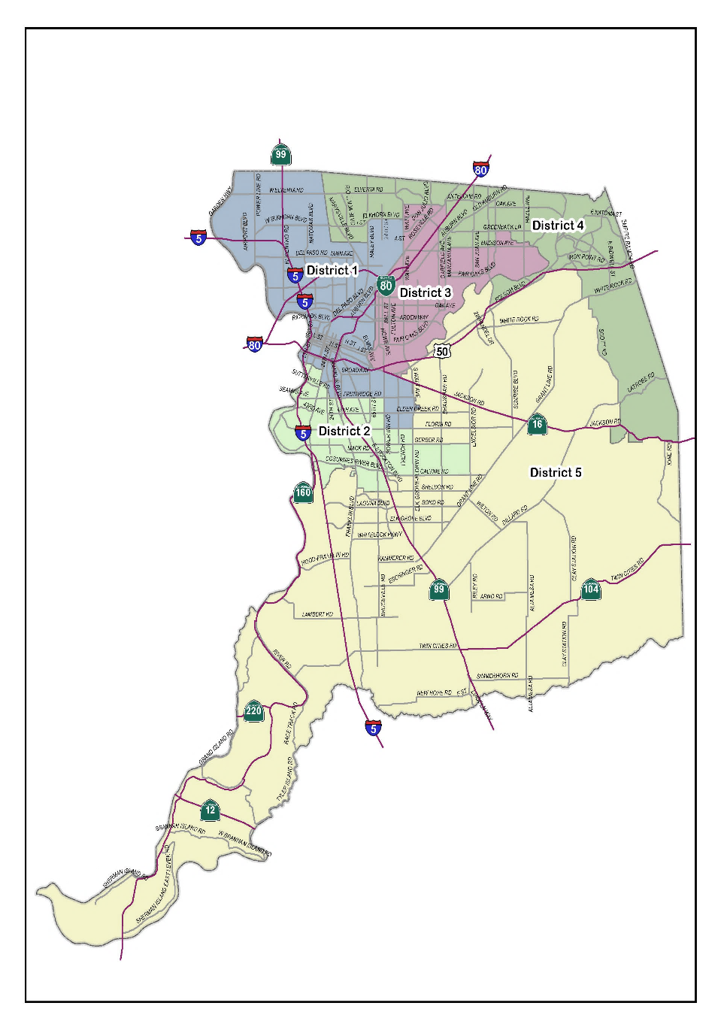
TOT GRANT PROGRAM OVERVIEW
In 2017, the County Board of Supervisors established the TOT Grant Program to provide financial support, through a competitive application process, to non-profit organizations that carry out community-based programs and/or services in Sacramento County.
During the recommended budget hearing on June 5, 2024, the Board of Supervisors approved the allocation of $1M to fund another year of the program.
Page 3

Slide 4
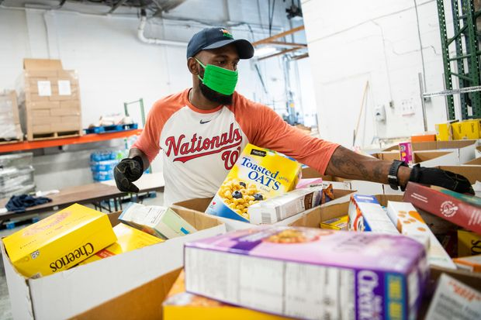
TIMELINE
Open Application Period :
January 13, 2025 – February 14, 2025
Application and supplemental material must be submitted by 5 p.m. on Friday, February 14, 2025.
Online Applications Only: Applications are only accepted electronically through the Portal.
Grant Application Review Period: February 2025 - April 2025
Grantee Award Approval and Notifications: June 2025
Page 4

Slide 5
INSURANCE REQUIREMENTS
Agreement with County contains insurance requirements
Insurance provides coverage for claims if they arise from the organization’s activities.
Protects both your organization and the County from financial loss.
Standard Requirements
General Liability
Auto Liability (Commercial or Personal)
Workers’ Compensation/Employer’s Liability
Evidence of Insurance
Certificate of Insurance
Policy Endorsements (Additional Insured, Waiver of Subrogation, Primary and Noncontributory)
Recommend discussing with your insurance agent/broker in advance
Page 5

Slide 6
APPLICATION GUIDELINES & ELIGIBILITY
Policy Guidelines
Requests Amounts are:
Minimum funding request of $5,000
Maximum funding request of $50,000
Grant Period: 11 Months
July 1, 2025 to May 31, 2026
Awarded Grant funds are distributed on a reimbursement basis. .
Applicant Eligibility
To be eligible for funding, an applicant must:
Be a non-profit organization which has completed one fiscal year.
Note: Use of a fiscal sponsor is allowed. Fiscal sponsors must have similar organizational goals as the applicant’s organization and meet the same application eligibility requirements.
Have a physical presence and provide services in Sacramento County.
Page 6

Slide 7
APPLICATION GUIDELINES & ELIGIBILITY
We Fund Projects:
A project may consist of one or more specific events or activities.
A project may be a part of an applicant’s regular season or activities.
Organizations may apply for any or all phases of a project, from its planning through its implementation.
A project does not have to be new or large.
Page 7

Slide 8
APPLICATION GUIDELINES & ELIGIBILITY
We Do Not Fund:
Direct grants to individuals, sub-granting or re-granting, vouchers or co-payments.
Pass through or regrant funding to a government entity
Awards to individuals or organizations honoring or recognizing achievement.
City, county, state or federal government institutions.
For-profit enterprises or activities.
Capital campaigns, cash reserves or endowments.
Fundraising events, programs, or social activities such as receptions, parties, galas.
Debt reduction.
Costs incurred before the beginning or after the completion of the official term of the funding agreement.
Page 8

Slide 9
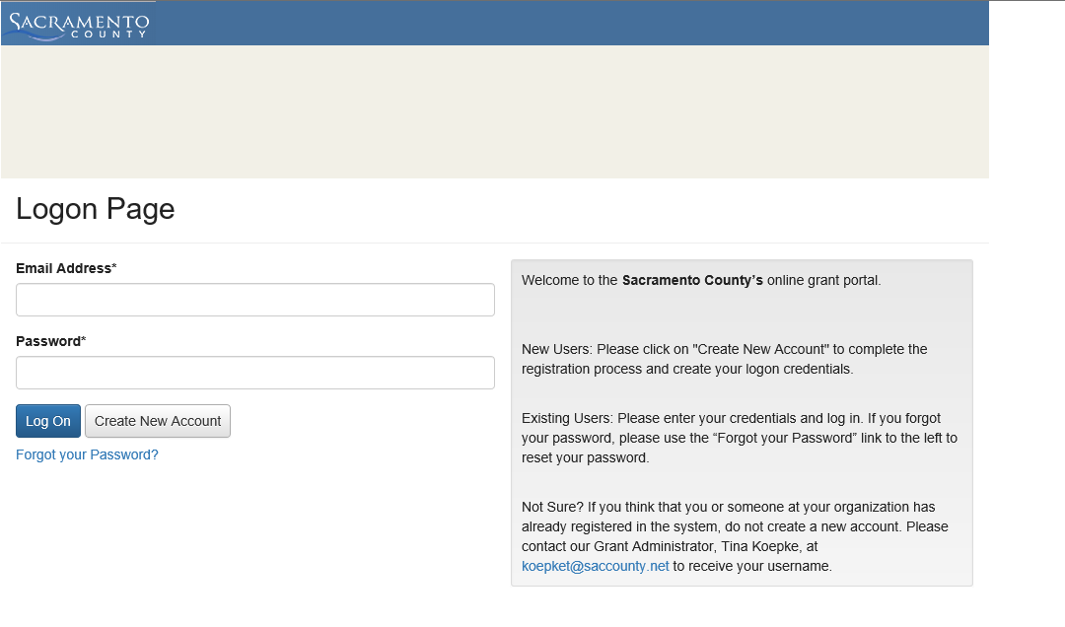
ONLINE APPLICATION - FOUNDANT
The 2025-26 TOT Grant Program application is web-based and requires an account to access the application. Detailed instructions can be found on our Webpage.
Log In
New Users: “Create New Account” to complete the Registration Process.
Existing Users: Enter your credentials and log in. A “Forgot your Password” link is available.
Not sure if your organization is registered, please contact SacCountyTOTAdmin@saccounty.gov
WE ONLY ACCEPT APPLICATIONS THROUGH THIS WEB-BASED PROGRAM
Page 9

Slide 10
ONLINE APPLICATION - FOUNDANT
Apply Online.
Upon accessing the system for the first time, you will land on the Apply Page. This page displays current open opportunities that you can apply for, relevant deadlines and/or other related information.
Complete Application Form.
In the form, contact and organization information automatically populates. An application can be saved or submitted.
No changes can be made to a submitted form.
Applicant Dashboard.
Your dashboard is where you can edit your saved application, review your submitted application and check on the status or follow-ups for your application.
Page 10

Slide 11
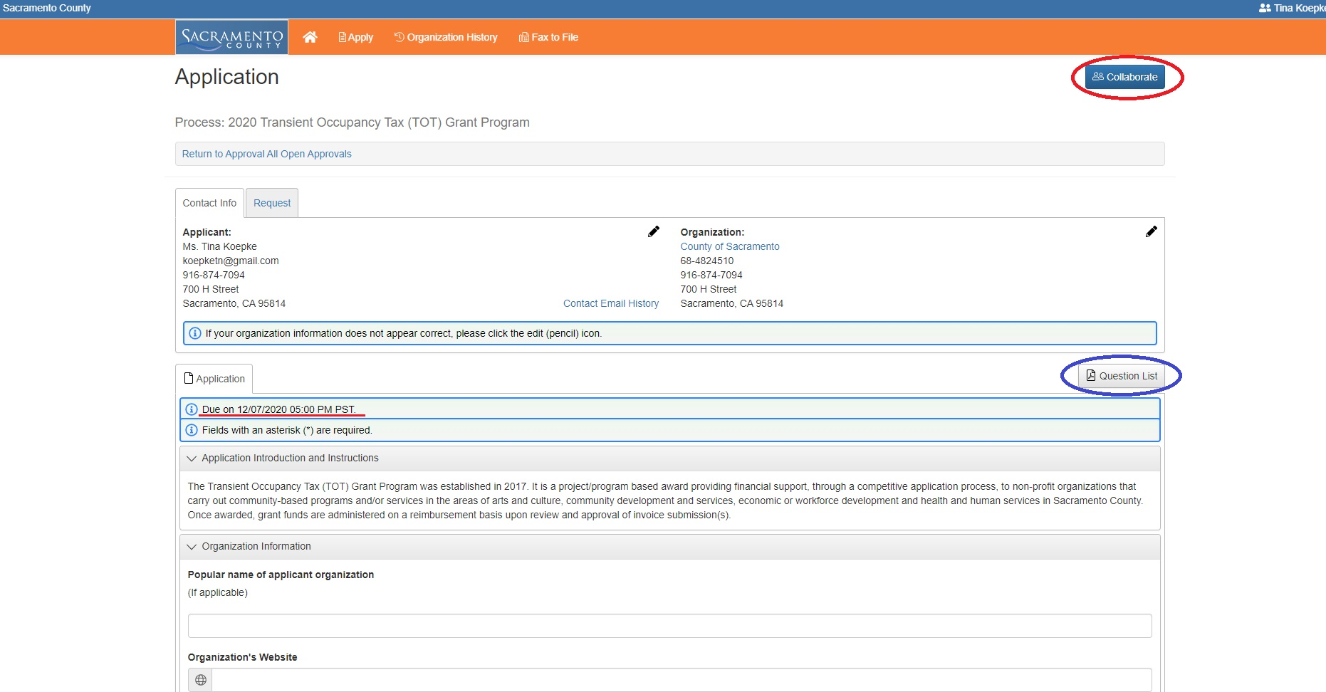
ONLINE APPLICATION - FOUNDANT
Application.
Clicking “Apply” from the Applicant Dashboard brings you the application. The Applicant and Organization information, the Due Date, a Collaborate feature and access to the Question list will be displayed.
Collaborate.
This feature allows an applicant to invite collaborators to view, edit and/or submit an application on the organization’s behalf.
Save and Submit.
Your application will be saved automatically on a frequent basis, however, there is a “Save” button at the end of the application along with a “Submit” button once the application is completed.
Page 11

Slide 12
APPLICATION
GUIDE
Organization Information & Narrative
Project Information
Project Narrative
Budget
Additional Documentation
Page 12

Slide 13
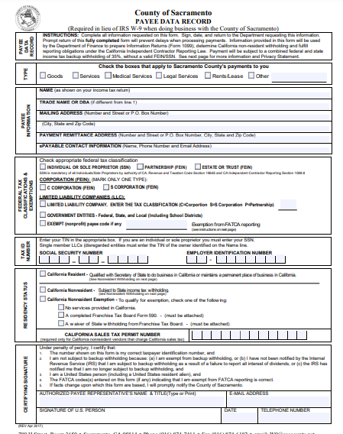
APPLICATION – Organization Information
In this Section, we’ll ask you to confirm some basic information for the organization, such as:
Organization Name
Physical Location
Provide a Payee Data Record Form
Information about the Fiscal Sponsor (as applicable)
General Notes for the Application:
Character counts include Spaces.
The application does Auto Save.
Please pay careful attention to page counts.
Questions? Please ask us.
Page 13

Slide 14
APPLICATION – Organization Narrative
Organization Category
Select the category that best describes the mission of the organization:
Arts and Culture
Community Development and Services
Economic or Workforce Development
Health & Human Services
2. Organization Description – 1500 Character Limit
Provide a brief description of your organization, its mission, and primary programs and services.
Page 14

Slide 15
APPLICATION – Organization Narrative
3. Accomplishments and Challenges – 1000 Character Limit
Summarize your organization's accomplishments and challenges over the past year.
Describe short and long term challenges. Additionally, describe any future plans for the organization.
4. Organization Administration – 1000 Character Limit
Explain how your organization's administration and board is structured. Include staff, number of board members, officers, board committees and their responsibilities.
Staff Qualifications or Biographies – 1200 Character Limit
Provide a list of Board members and key staff members with their biographies/qualifications to perform their role in the organization.
Page 15

Slide 16
APPLICATION – Organization Narrative
6. Number of Full Time Staff
Please enter the number of paid full-time employees of the organization.
6a. Number of Part Time Staff
Please enter the number of paid part-time employees of the organization.
6b. Number of Volunteers
Please enter the number of volunteers for the organization. This number should also include the Board of Directors/Members if they are not compensated by the organization.
7. Number of Years in Operation
How long has the organization been operating in Sacramento County as a non profit entity?
Page 16

Slide 17
APPLICATION – Organization Narrative
8. Total Organization Budget
Provide the total organization budget that will be supported by the upload in item #9.
Fiscal Year End Date
Provide the Fiscal Year End Date for the organization.
9. Final Adopted Fiscal Year Budget – Limit 2 pages
Please provide your last completed Fiscal Year budget which has been adopted by the Board of Directors.
A Budget Summary may be provided if the completed Fiscal Year budget exceeds 2 pages.
A space has been provided for any clarifications to the budget document submitted. (If the organization has a deficit or surplus of funds, please explain why)
Page 17

Slide 18
APPLICATION – Project Information
10. Project Title – 75 Character Limit
Please provide a descriptive title for the application project/program.
11. Project Summary – 300 Character Limit
Provide a brief overview of how the grant funds would be used. This description will be used to introduce your proposal to the Review Panel and Board of Supervisors. If funded, it will be used to describe your approved grant.
12. Total Grant Amount Requested
Minimum request level is $5,000 and may not exceed $50,000.
Organizations should apply for no more than 20% of their last FY Budget or $5,000 (minimum request) whichever is larger.
13. Project Location (Supervisorial District)
Please indicate where the project will take place
14. Communities Served by Project
Select All that Apply
Page 18

Slide 19
APPLICATION – Project Narrative
15. Project Description – 2000 Character Limit
Provide a detailed description of the proposed project. Emphasize how this project will serve the Sacramento Community through innovation, education, training, tourism or the underserved.
16. Project Timeline – Activities & Outcomes – 1000 Character Limit
Describe the timeline for implementation of your project over a 11 month period. The timeline should list key dates/months that correspond to the description of the activities to take place on those dates/months and expected outcomes.
The timeline should reflect what will be in the project Scope of Services, should your organization be awarded a TOT Grant.
17. Description and Demographics of Community Served – 750 Character Limit
Please describe the demographics (age, ethnicity, income, education level if available) and characteristics of the community where your project will take place.
Page 19

Slide 20
APPLICATION – Project Narrative
18. Project Community Impact – 750 Character Limit
Provide and explain:
How many people will benefit from the project? Include an explanation of how you calculated this number.
Describe the specific needs of the community and how this project will meet those needs.
Additionally, explain how this project will attract, recruit and engage this community
19. Relationship and Experience – 750 Character Limit
Describe your organization’s relationship to and experience working with this community.
What demonstrated successes have you had with this or other projects/programs within this community?
Page 20

Slide 21
APPLICATION – Project Narrative
20. Evaluation and Measurements – 750 Character Limit
How will your organization measure the success of the project? Explain the specific quantitative methods that will be used for evaluating and measuring the project's success. For example, number of participants or people served, pre and post surveys, social media platforms metrics, statistics etc. If this project has been produced in the past, please include the outcomes.
21. Project Sustainability & Future Funding Plan – 750 Character Limit
Describe how your organization will address the income gap if the TOT Grant does not fully fund your request. For example, the program will be cancelled or modified, expenses will be cut, additional funds will be sought or are already in hand, etc.
Indicate ways in which future funding needs for your requested project will be addressed after funding from the TOT Grant has ended. For example, if your project request is for an ongoing program or project, how will the funding be secured in the future?
Page 21

Slide 22
APPLICATION – Project Narrative
22. Location Improvements
Do you plan to make changes to your physical location to facilitate the success of your project? *If yes, a letter of support is required from the property owner and a long term lease is recommended.
Long-Term Lease Upload
If you answered “yes” to question #22, please upload the letter from your property owner and a copy of the long-term lease.
Page 22

Slide 23
APPLICATION – Budget
23. Total Project Budget – 20 Character Limit
Provide the total budget for the proposed project or program. (This includes
your requested funding and any other funding needed.)
24. Minimum Amount for Project to Take Place
Minimum amount from the TOT Grant funding required for the proposed project to be started and completed. (Between $5,000 - $50,000)
25. Percent of Overall Project Budget – 4 Character Limit
Please provide the percentage of your request in relation to your overall project budget.
26. Percent of Organization Budget – 4 Character Limit
Please provide the percentage of your project budget in relation to your overall organization budget.
Page 23

Slide 24
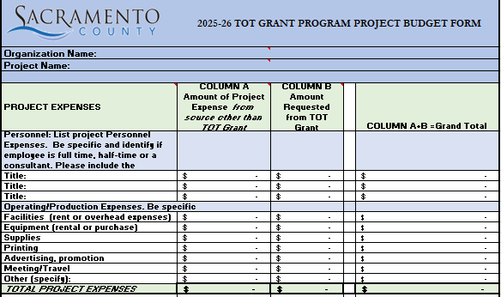
APPLICATION – Budget
27. Project Budget Form
Please download this budget form for submission, no other budget form will be accepted. Complete and upload to application.
Page 24

Slide 25
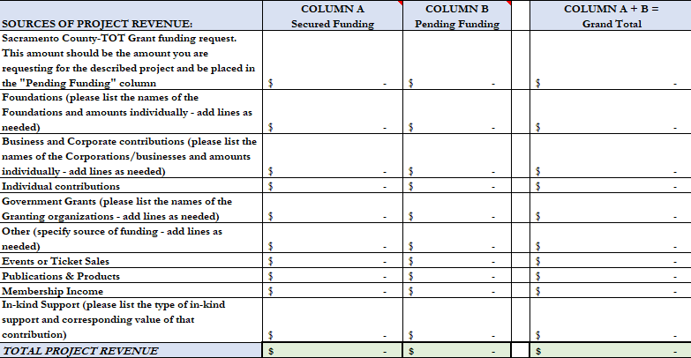
APPLICATION – Budget
Project Revenue
Page 25

Slide 26
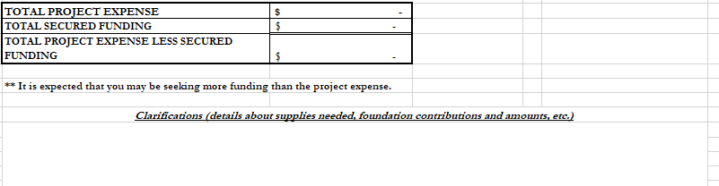
APPLICATION – Budget
Project Budget Form - Summary
Project Budget Clarifications (optional) – 300 Character limit
Any budget clarifications or additional details may be included on the budget form itself such as:
details about supplies needed
foundation contributions and amounts
Mention of a quote for equipment
Page 26

Slide 27
APPLICATION – Additional Documentation
Organizational Support Samples
Please upload documentation to directly support your application. Documentation
should speak to the specific need, expertise and impact the organization will have on the
community to be served.
3 files (Word or PDF format)
File size limits: 2 MB each
No more than 5 pages
Samples can include:
Letters of Support or Testimonials from past participants, members of your organization and/or the community are highly recommended.
Newspaper, magazine articles, annual reports, or other publications featuring
stories about your organization.
Brochures, postcards, programs, newsletters or other promotional materials.
Page 27

Slide 28
APPLICATION REVIEW
Applications will be reviewed on the basis of the following:
Quality and Capacity of the Organization (15 Points)
The organization has significant accomplishments.
Clear budgetary/financial information.
Confidence in the organizations ability to carry out the project.
Supplemental material enhances the application.
2. Strength of Proposed Project (15 Points)
Project is clear and concise.
Resources needed for the project completion are identified.
Project relates to the organizations mission or the community it serves.
Project can be completed within the proposed timeline.
Intended outcomes and methods for evaluating and measuring success are fully articulated.
Page 28

Slide 29
APPLICATION REVIEW
Applications will be reviewed on the basis of the following:
3. Project Impact and Sustainability (20 points)
A detailed description of the community to be served is clearly outlined.
Organization’s mission and programs are connected to the community the project will serve.
Compelling explanation of the community need and significant impact from the project.
Supplemental material clearly demonstrates the organization and the community it serves.
Page 29

Slide 30
WHAT HAPPENS TO YOUR APPLICATION?
Applications are evaluated according to the “Review Criteria”.
STEP 1: County staff review applications to ensure they meet minimum qualifications. Incomplete applications will not be considered.
STEP 2: Applications are reviewed, in closed session, by advisory panelists. Each panel comprises a diverse group of experts with knowledge in the areas under review and ranked.
STEP 3: Panelist recommendations are reviewed by the County Board of Supervisors TOT Committee.
STEP 4: County Board of Supervisor TOT recommendations are reviewed by the County Board of Supervisors at a regularly scheduled meeting and makes the final decision on all grant awards.
Applicants are notified of funding decisions.
Page 30

Slide 31
Questions
APPLY ONLINE
Deadline to apply: Friday, February 14, 2025 (5pm)
Awards Anticipated Announcement: June 2025
Details: https://bdm.saccounty.gov/TOTGrantProgram
Questions: Email - SacCountyTOTAdmin@saccounty.gov

